Slide 1

High Value Customers
Making the Most of Our Marketing Dollars

Slide 2
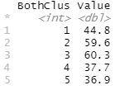
Consumer Segmentation
Consumers segmented based on brand loyalty and basis for purchasing
This segmentation shows clear separation in average value per transaction
Segments 2 & 3 represent 21.9% of total consumer market
Consumer Segment 2 & 3 are most valuable
Average value on right

Slide 3

Conclusion
Targeting consumer segments 2 & 3 with the majority of ad spend will result in acquiring highest value customers
This will lead to higher revenue with the same amount of ad money spent

